Slide 1

Final Iteration
MET CS 673 Professor Yuting Zhang
Team 1 : Wasupol, Peter, Ananya, Michael, Jian

Slide 2

Table of Contents
0 1
Project Overview
02
Requirement Analysis
03
Iteration Review
04
Design and Implementation
05
Testing, Project, Management, and Deployment

Slide 3


Project Overview
With so many social media and applications,
We still long for intimacy, privacy, and communication with our inner circles such as our close friends and loved ones.
We share our readings, music, opinions, and daily stories freely, We feel the same feel of our close ones, we feel that we are connected.
Here, we are a concrete person instead of a mixture of tags, titles, or fancy pictures.
Target audience: high school and college students, urban youth, and young professionals...
Notes:
Jian Ma - speaking
Storyboard?

Slide 4
01
Requirement Analysis

Slide 5
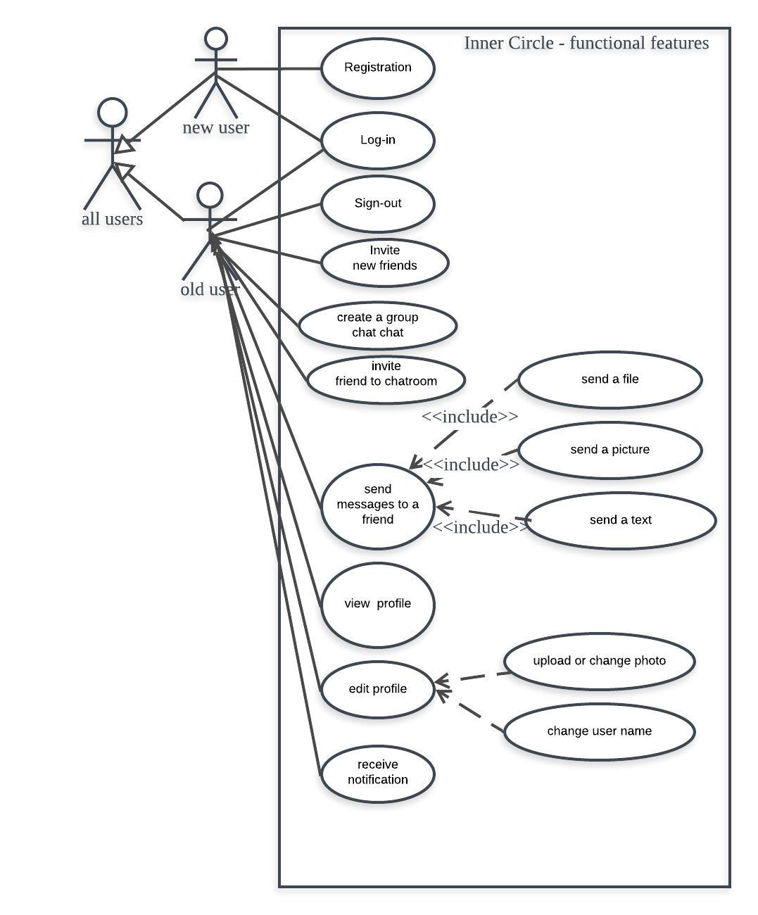
User stories
As a user, I want to have the authorization with social media accounts, so that I can ensure my security and my comfort using the Inner Circle application.
As a user, I want to start a new conversation by being able to initiate a new chat window with a newly friend using the Inner Circle application
As a user, I want to add/remove/change my profile picture or my user name
As a user, I want to search a specific friend by name, and then send they a message or view their profile.

Slide 6
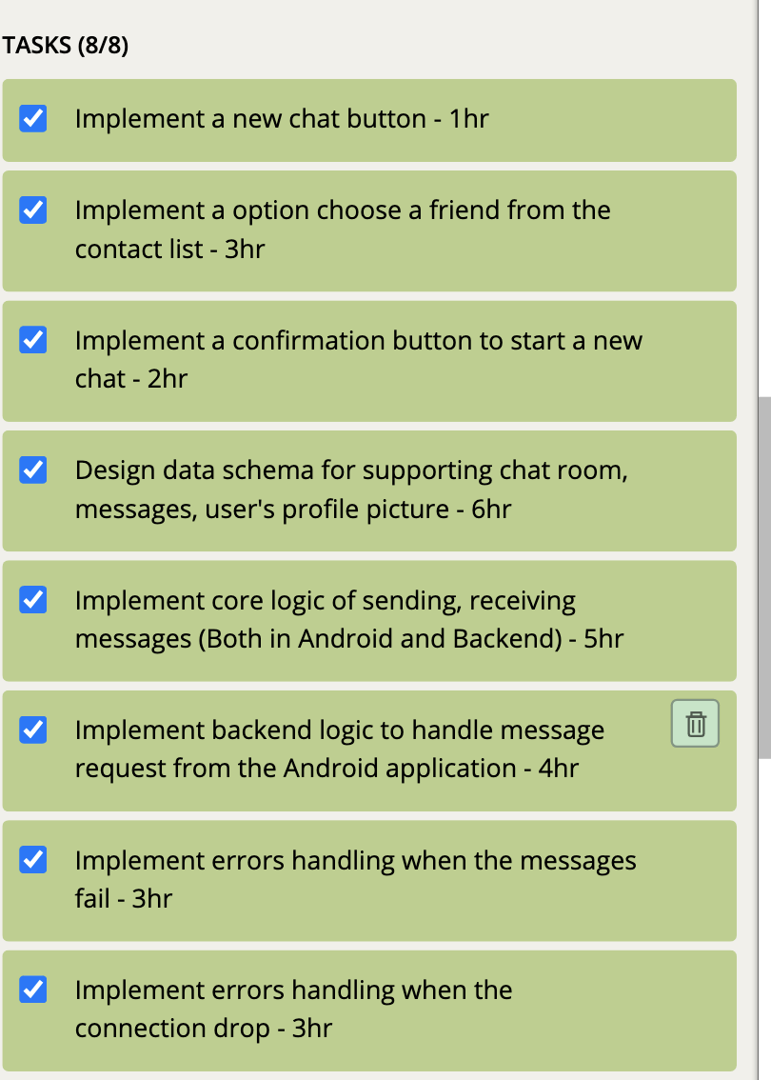
Story points and plan
authorization
Estimation: 5 points - 25 hours
Actually used: 23 hours
start a new conversation
Estimation: 5 points - 25 hours
Actually used: 23 hours
add/remove/change my profile
Estimation: 3 points - 15 hours
Actually used: 27 hours
search a specific friend
Estimation: 3 points - 15 hours
Actually used: 25 hours

Slide 7
How we handled changes
Weekly meetings promote communications
Pair programming
Product backlog sets development priorities
Task boards make developer tasks and details visible
Pivotal Tracker
To do
In progress
In testing
Done
Programing tutorial session
Narrow down scope

Slide 8
02
Iteration Review

Slide 9
Iteration 0 Review
Plan and discuss the following
Semester project application idea
Implementation Plan
Quality Assurance Plan
Configuration Management Plan
Security
Risk identification
Selecting tech stack

Slide 10
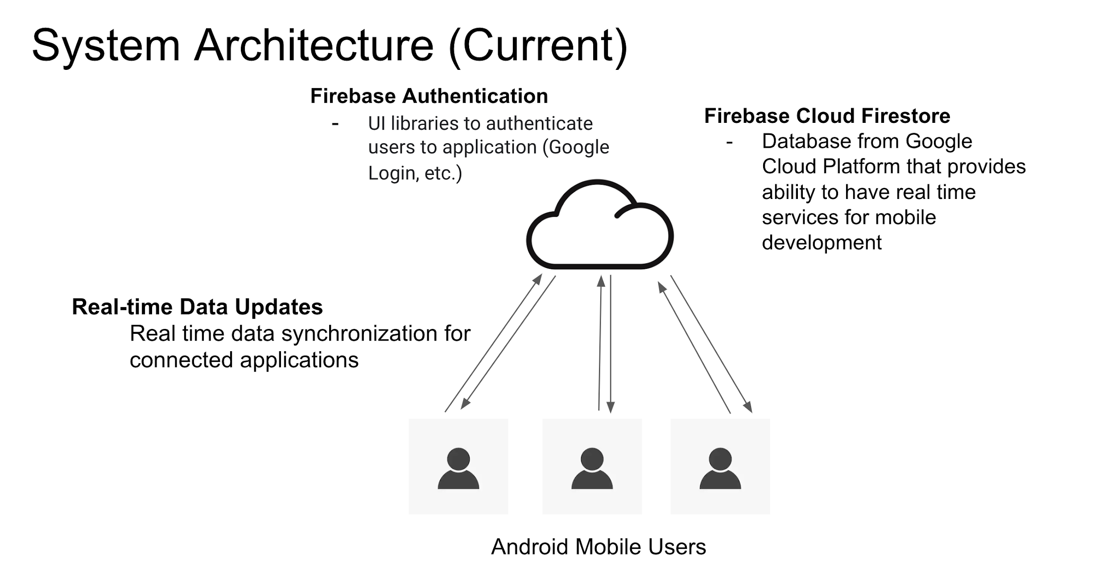
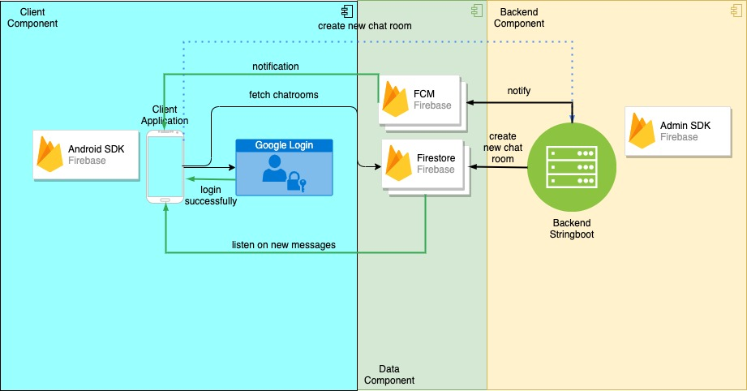
Iteration 1 Review
Requirements analysis and feature prioritization
Initiated feature implementations:
Google log-in
One-to-one chat room
System design

Slide 11
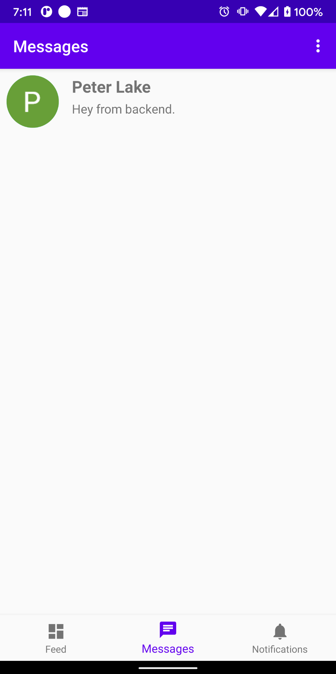
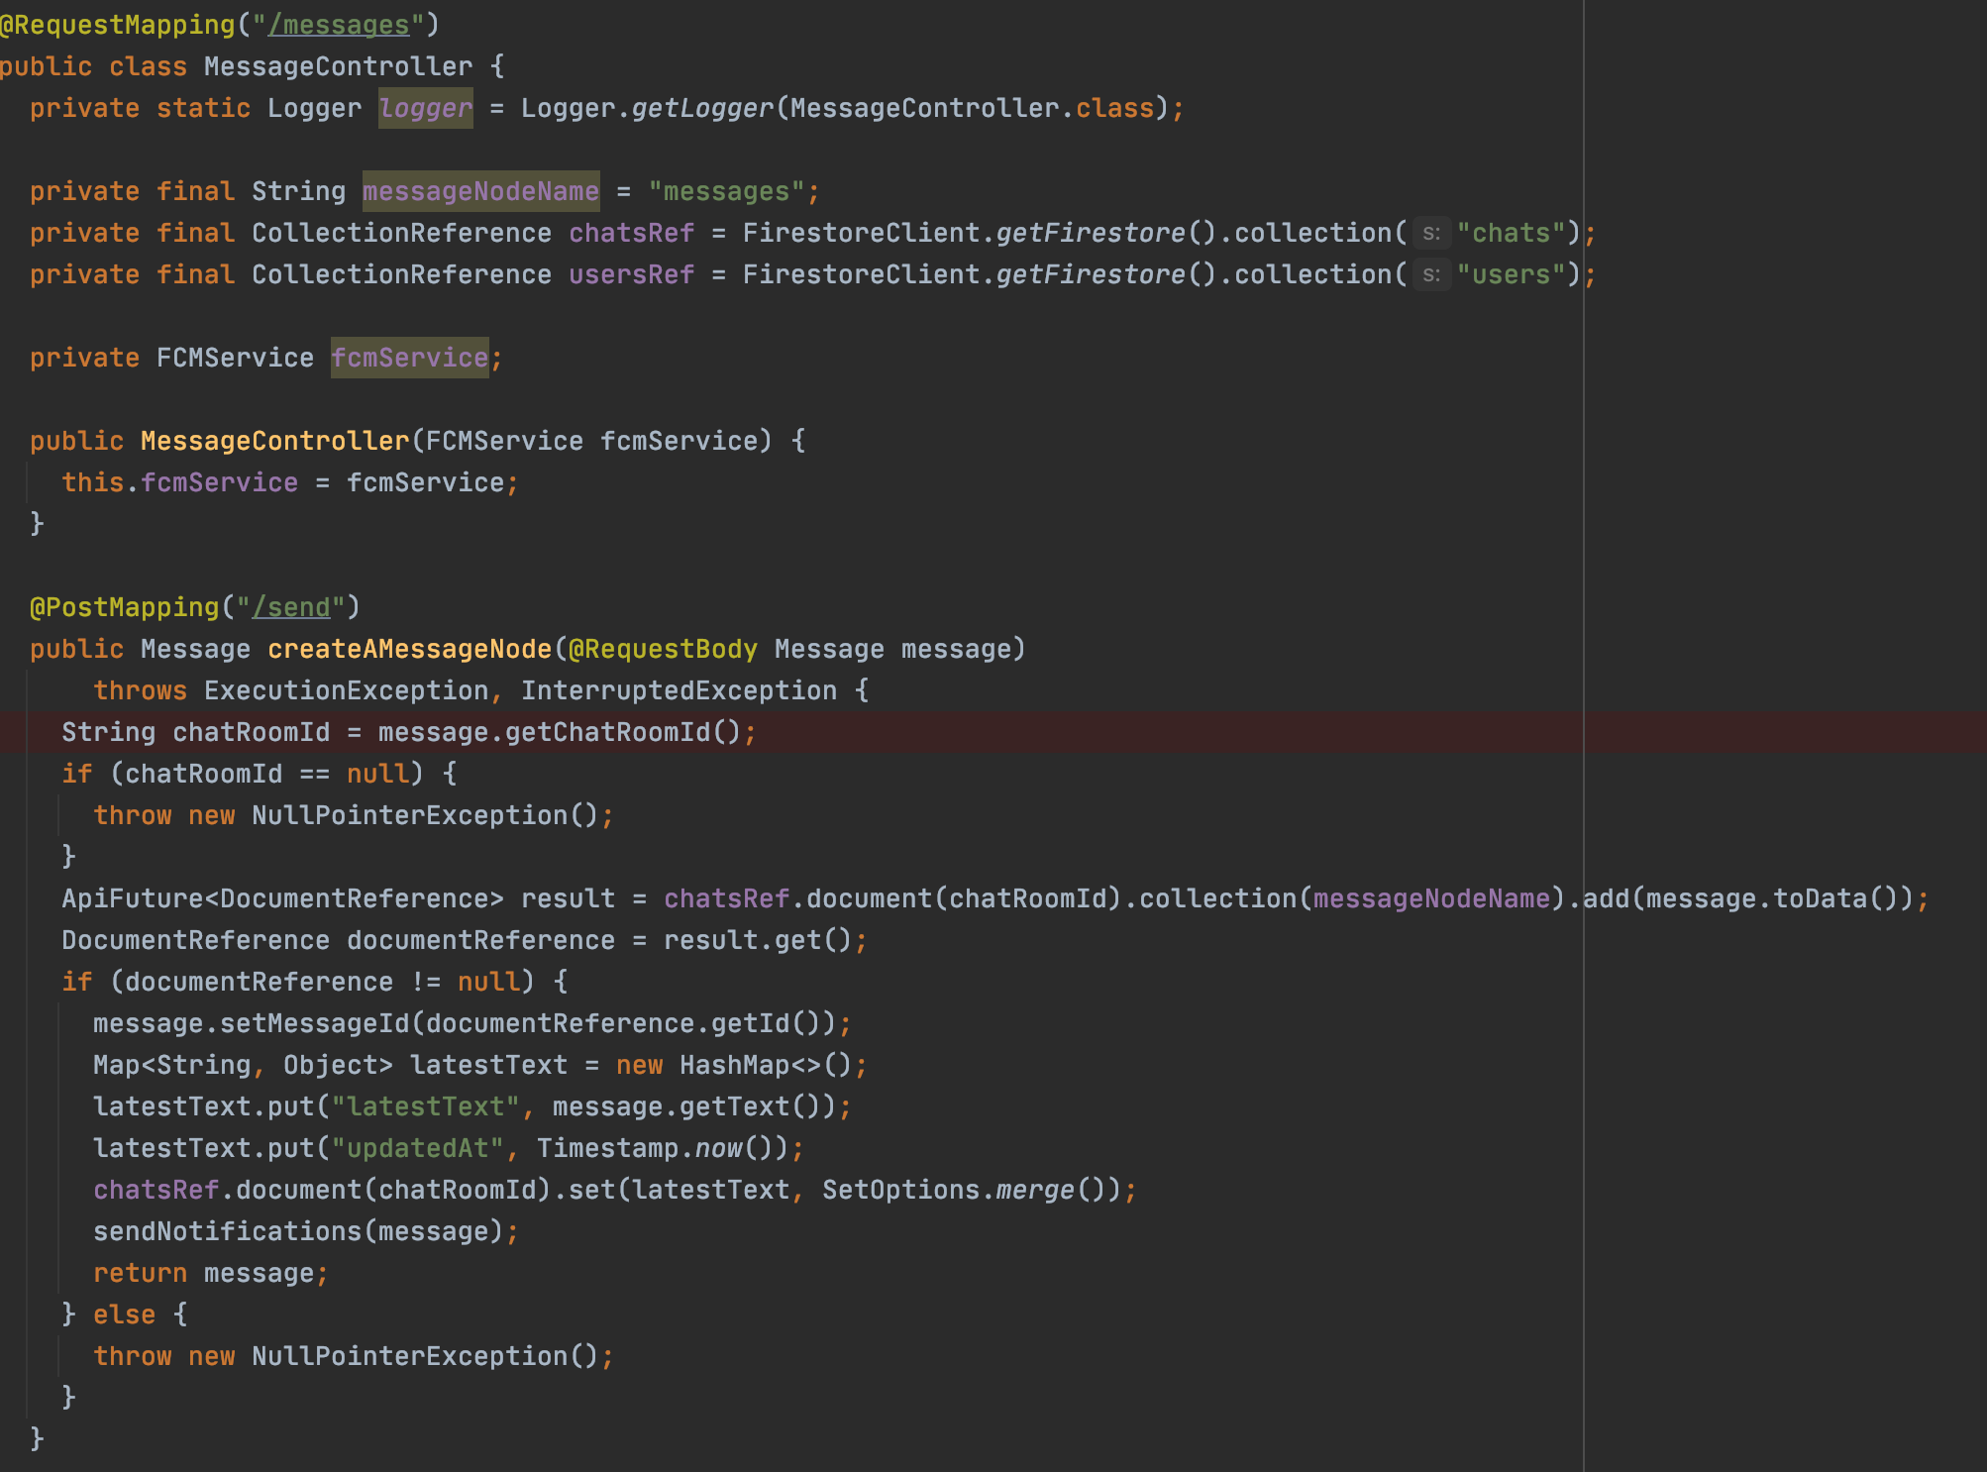
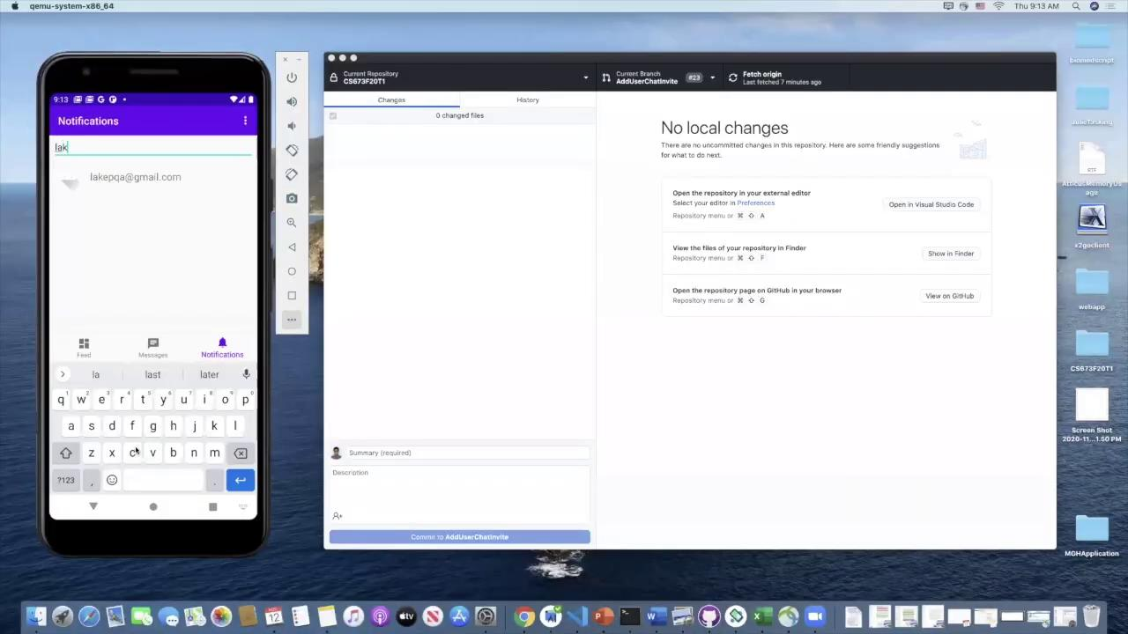
Iteration 2 Review
Initiated following feature implementations:
Backend System Design
Fetch chat rooms from backend
Create chat room from backend (by call backend directly)
Query new chat users

Slide 12
Iteration Three Requirements Analysis
Backend Implementation
Create chat-room with new user
Receive push notifications
Add profile picture (Backend)
View profile of participant
Logout (Remove deviceToken)
Online status
Android-Backend integration
Chat-room with multiple users (in progress)

Slide 13
03
Design and Implementation

Slide 14
Design and Implementation
What we achieve?
Code structures
Diagrams
Refactoring

Slide 15
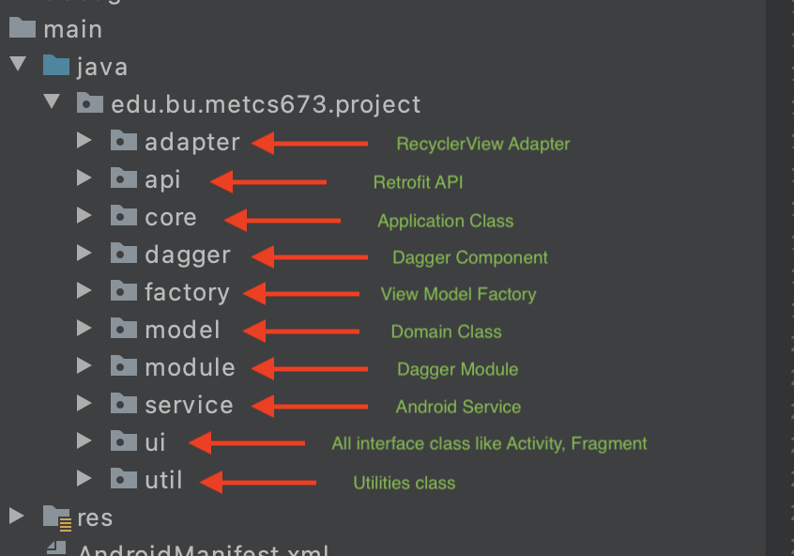
Android Code Structure

Slide 16
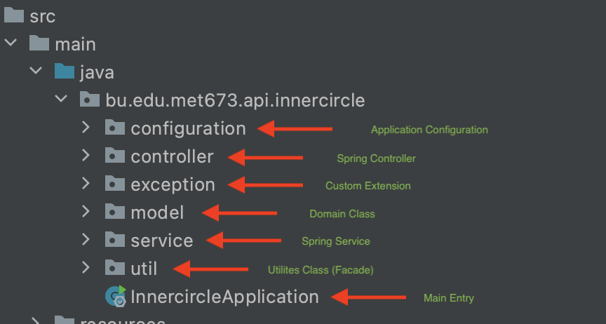
Backend Code Structure

Slide 17
Design and Implementation: Refactoring
Code Smells
Bloaters (Long methods, Large Class)
Magic String and Variables
Object-Orientation Abusers (Temporary Fields)
Dispensables (Duplicated code)
Techniques used
Platform tools (Android features)
Strategy Pattern
Singleton Pattern
Delegate Pattern
Dependencies Injection
Dagger 2 Library

Slide 18
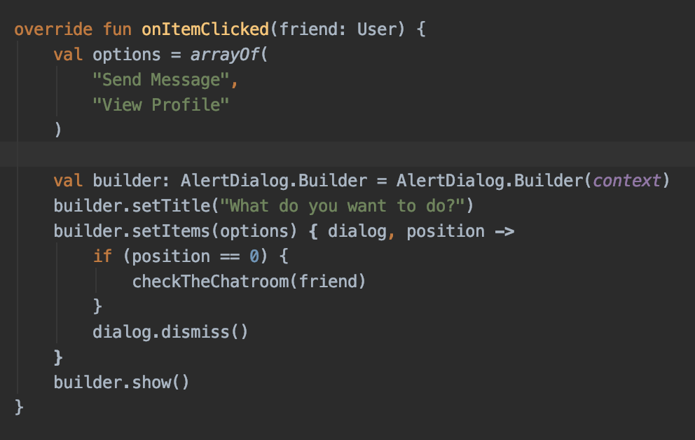
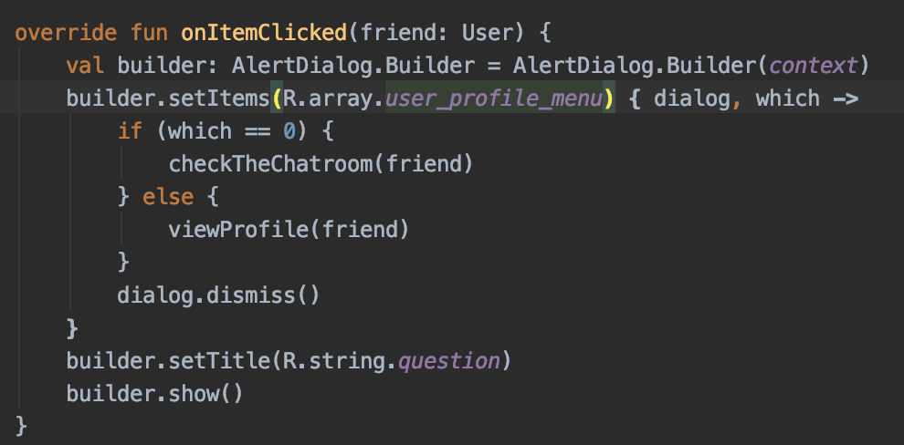
Design and Implementation: Refactoring
Use Android Resource
Magic String

Slide 19
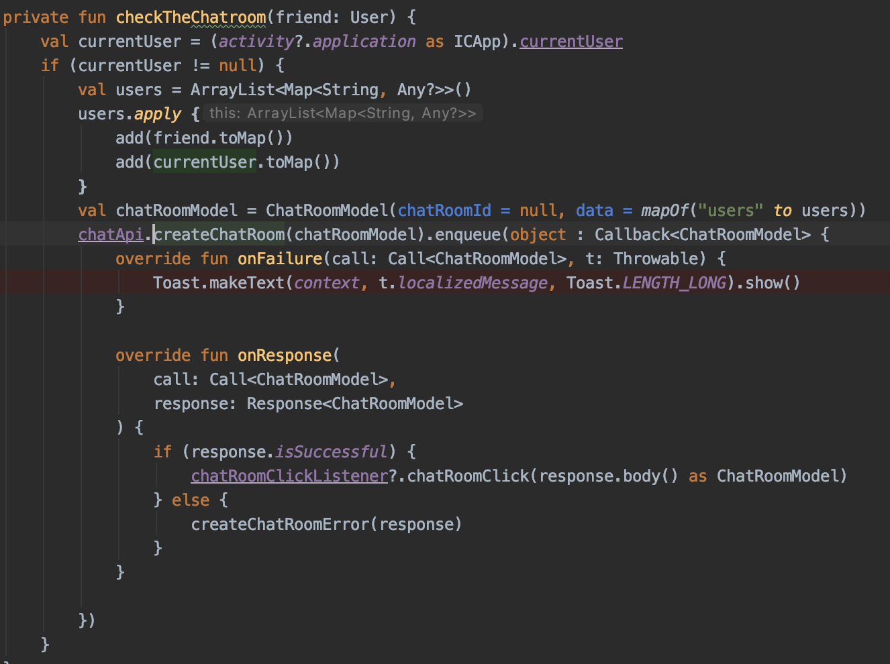
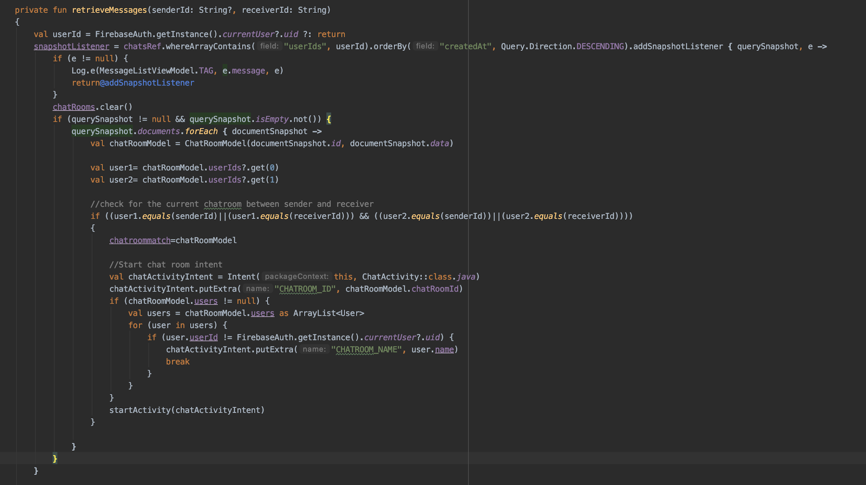
Design and Implementation: Refactoring
Create a Chat Room from Client Side
Long and Complex method
Refactor use DI and Interface

Slide 20
04
Architecture

Slide 21
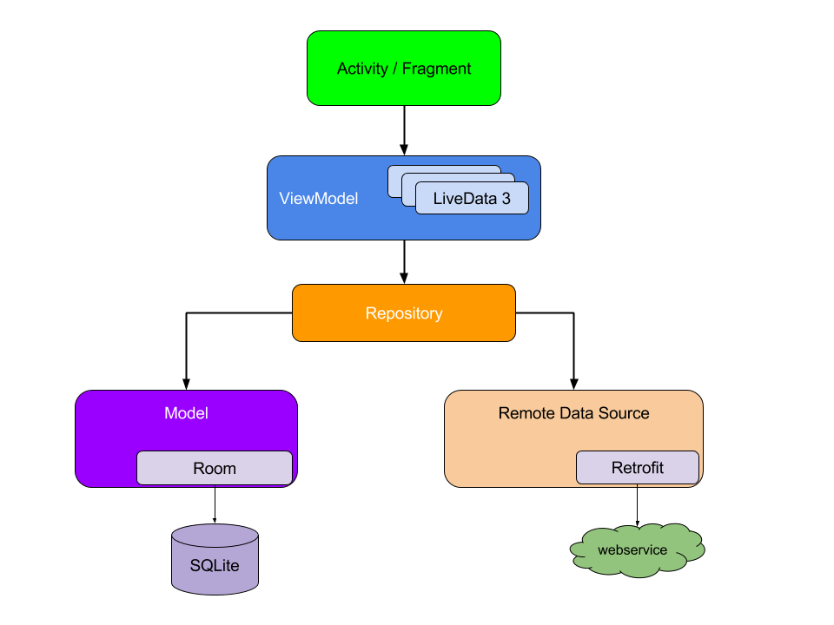
Client Architecture (Android) MVVM

Slide 22
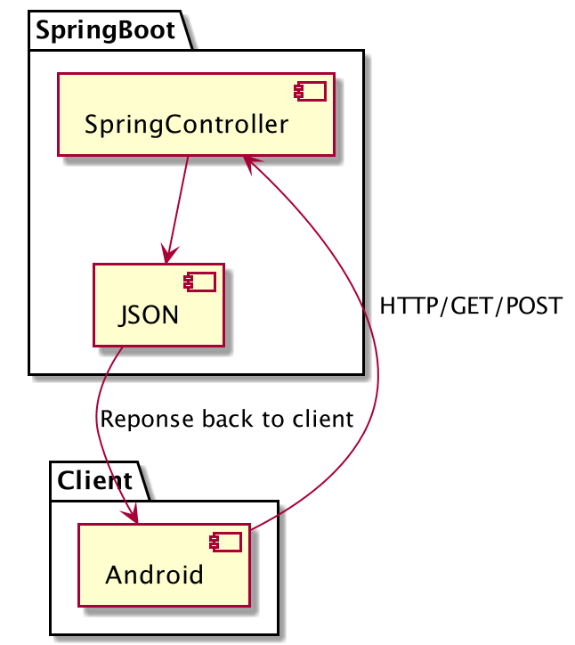
Backend Architecture (Java Spring Boot)

Slide 23
Design Patterns Used
Facade Pattern
Adapter Pattern
Strategy Pattern
Observer Pattern
Iterator Pattern
Abstract Factory
Singleton Pattern
Delegate Pattern

Slide 24
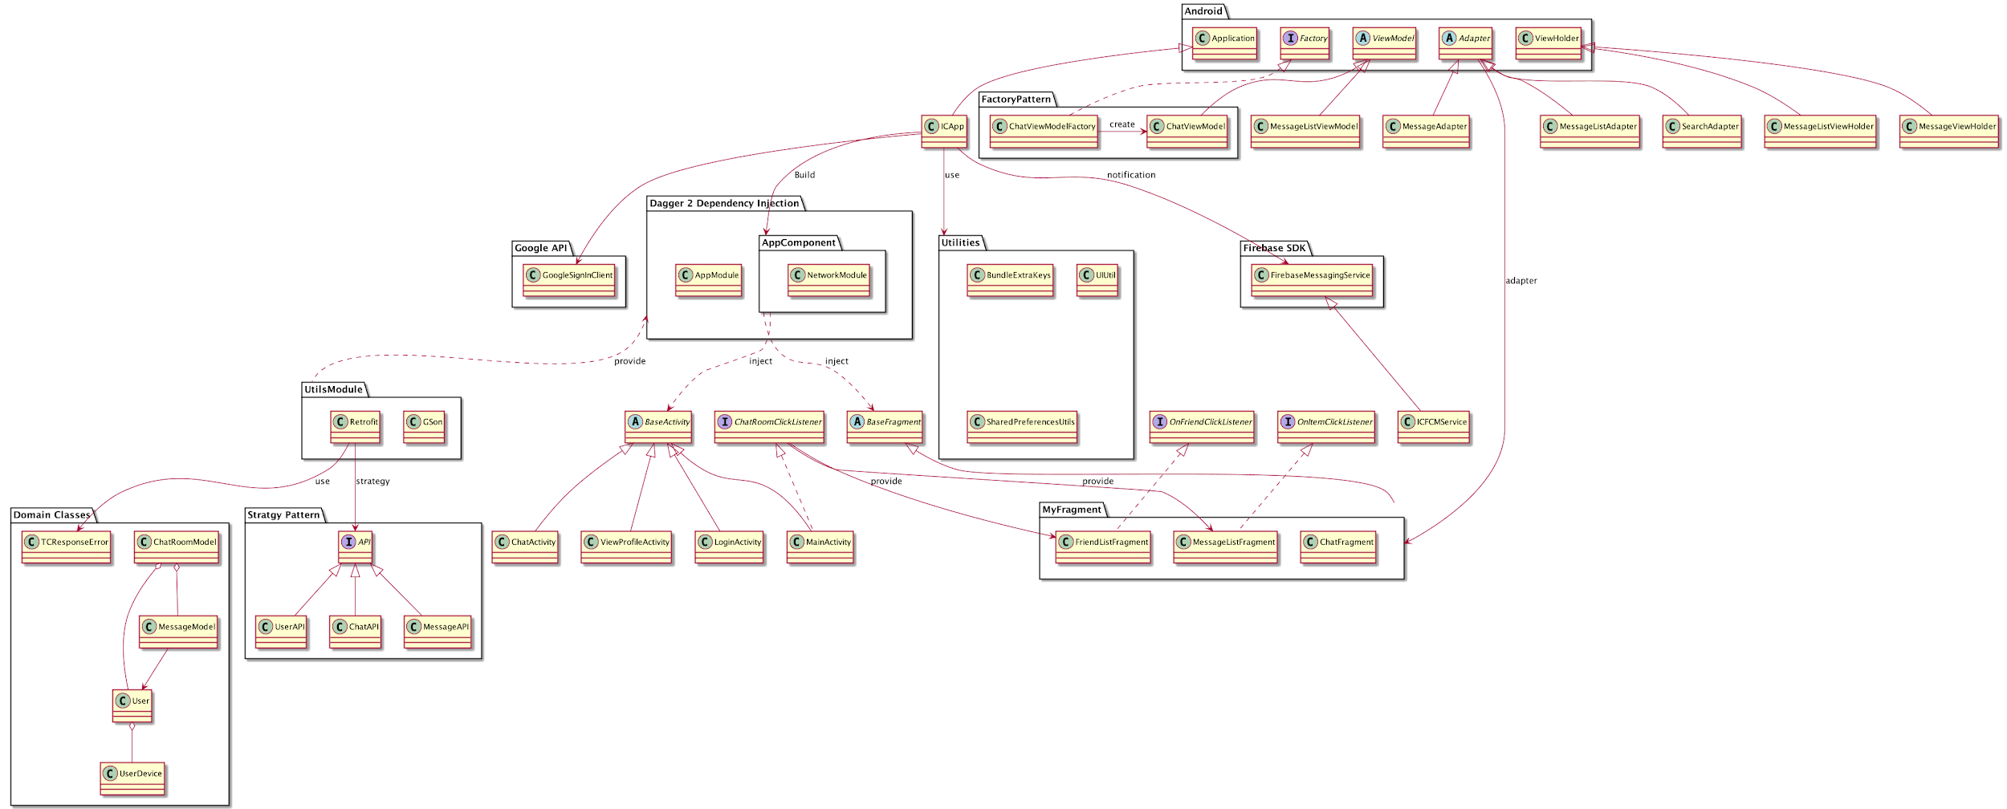
Android Class Diagram

Slide 25
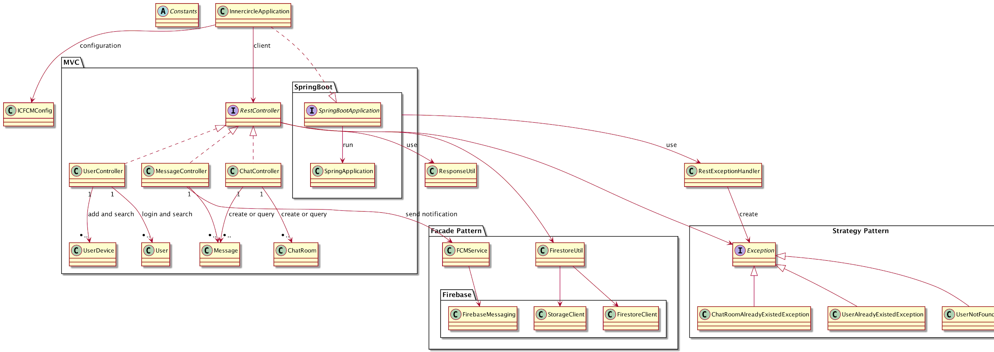
Backend Class Diagram

Slide 26
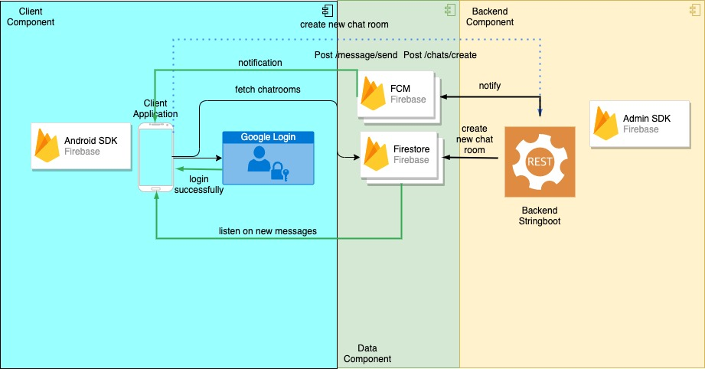
System Architecture (Iteration 2)

Slide 27
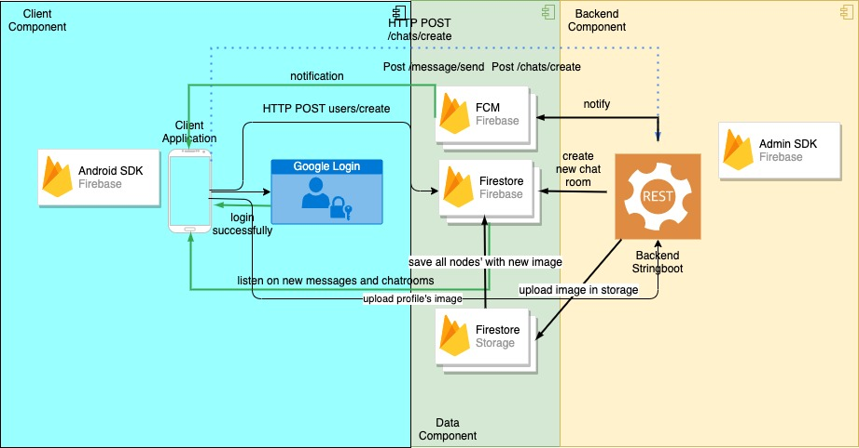


System Architecture (Current)

Slide 28
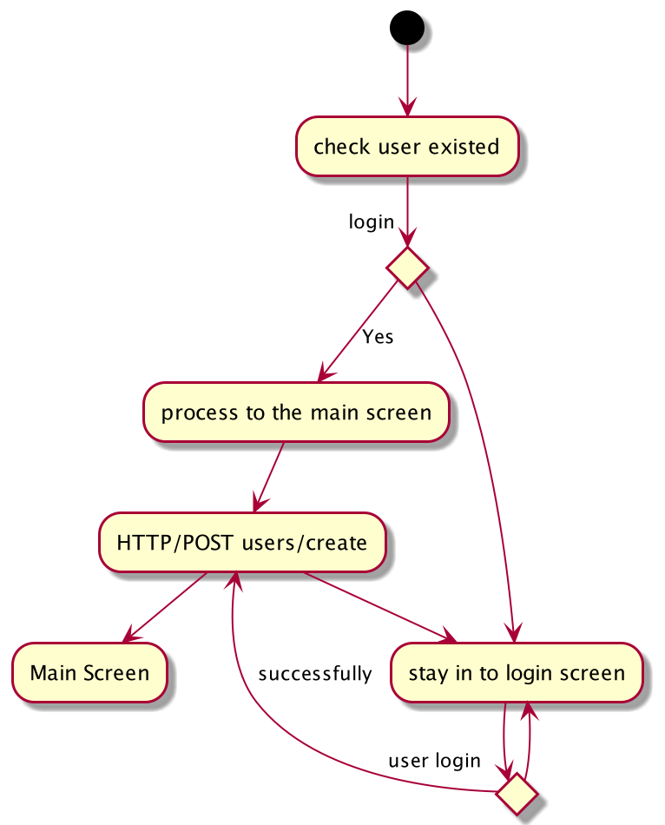
Login Activity Diagram

Slide 29
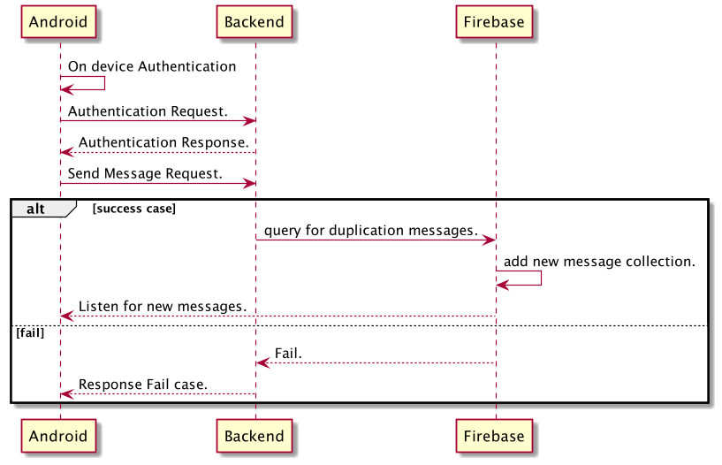
Send Message Sequence diagram

Slide 30
Backend Implementation
Using Spring Boot Java API (Restful) to do heavy load of CRUD operation
Avoid duplication
Additional core logics are implemented
Remove code smells in Android

Slide 31
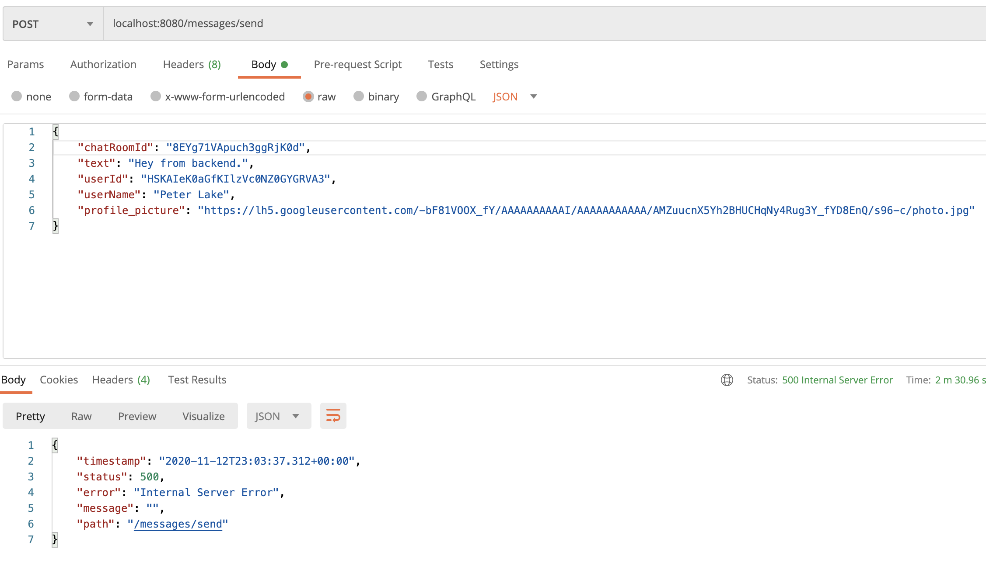
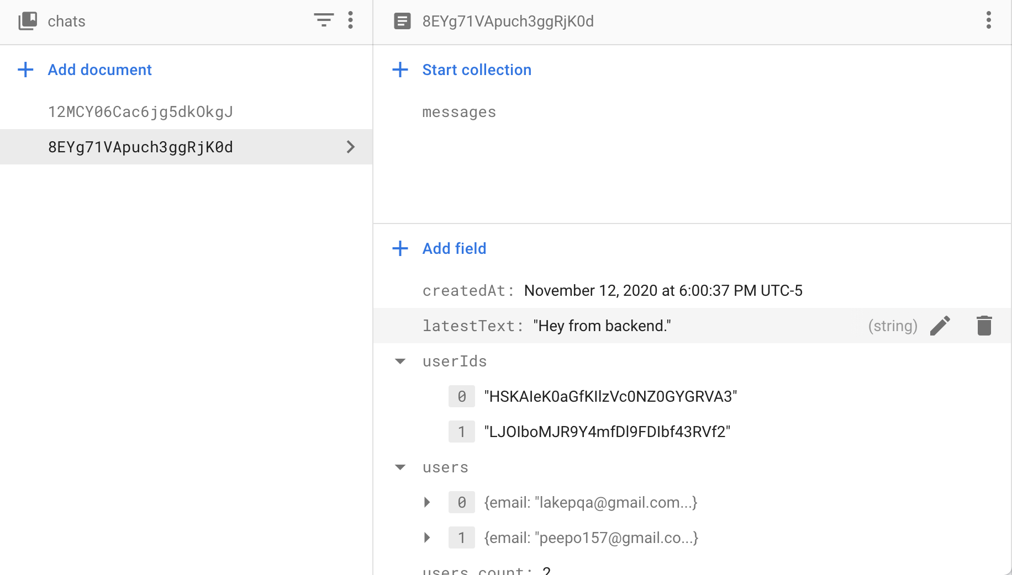
Backend Implementation (Send a message)

Slide 32
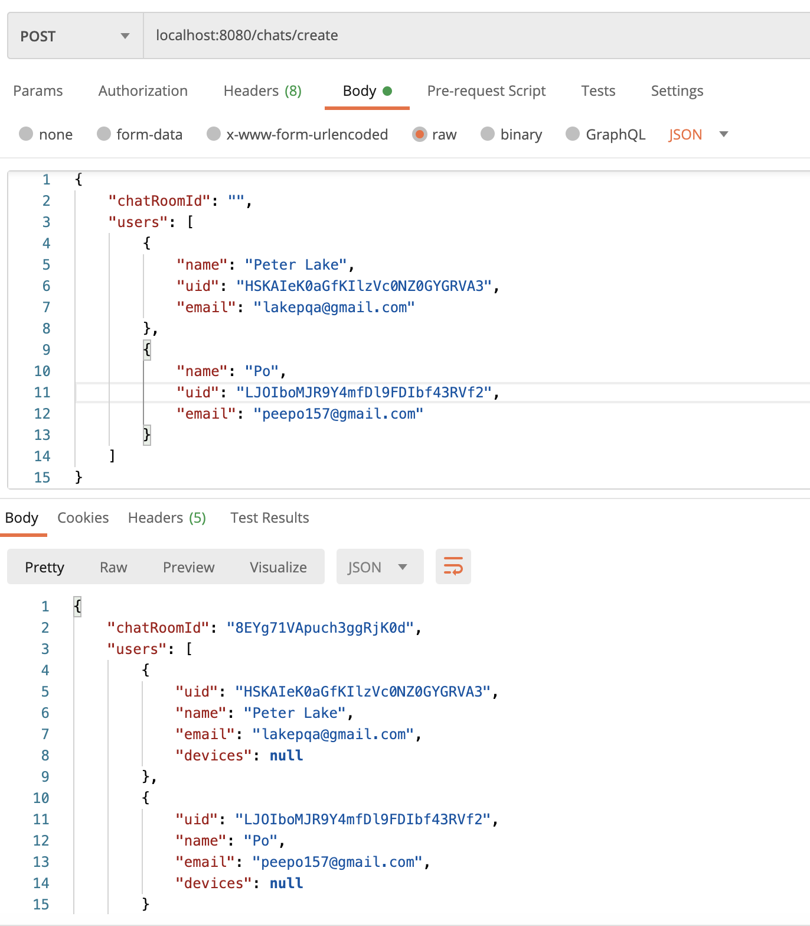
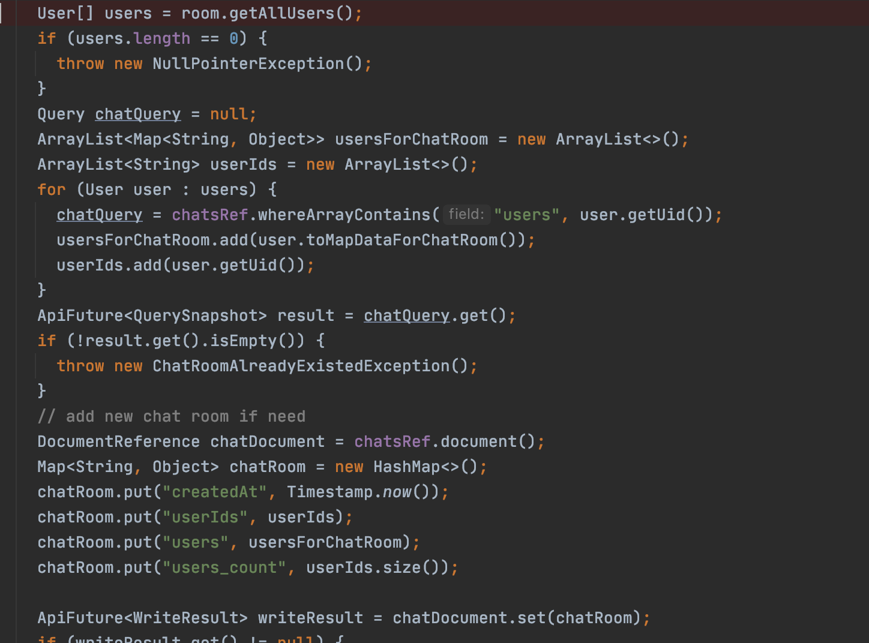
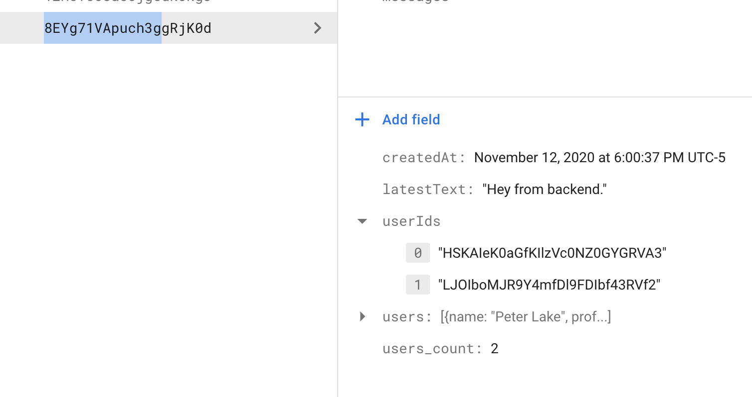
Backend Implementation (Create a chatroom)

Slide 33
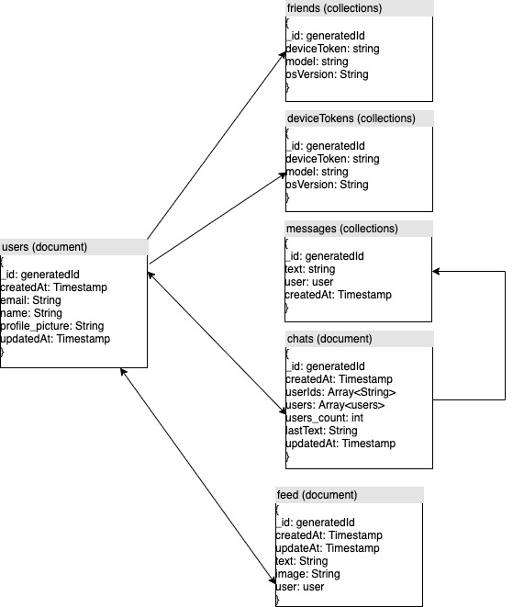
Data Design (noSQL document type)

Slide 34

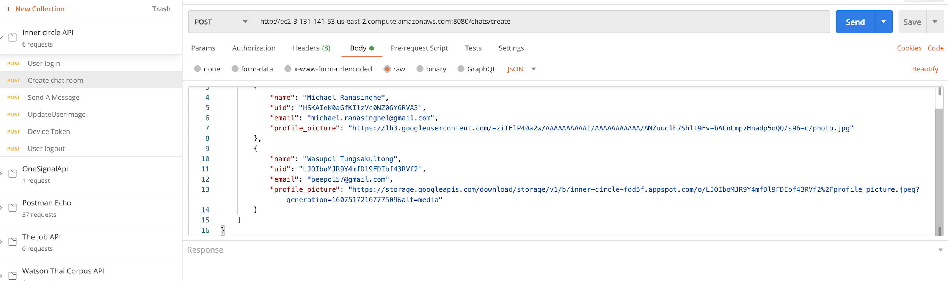
Additional Tools
Postman for API Test

Slide 35
05
Testing, Project Management, and Deployment

Slide 36
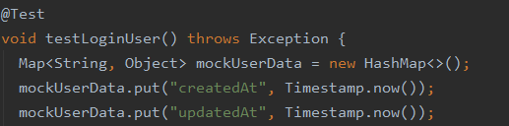
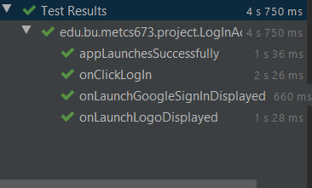
Testing and QA
Unit tests: Partial test coverage of front end / back end w/ JUnit
Manual Acceptance Tests:
Login/logout
Friends list searching
Initiating chats
Sending/receiving messages
Viewing profiles
UI tests: Espresso
Tested functionality and display of UI elements in multiple activities

Slide 37

UITest Video

Slide 38
Unit Test in Backend

Slide 39
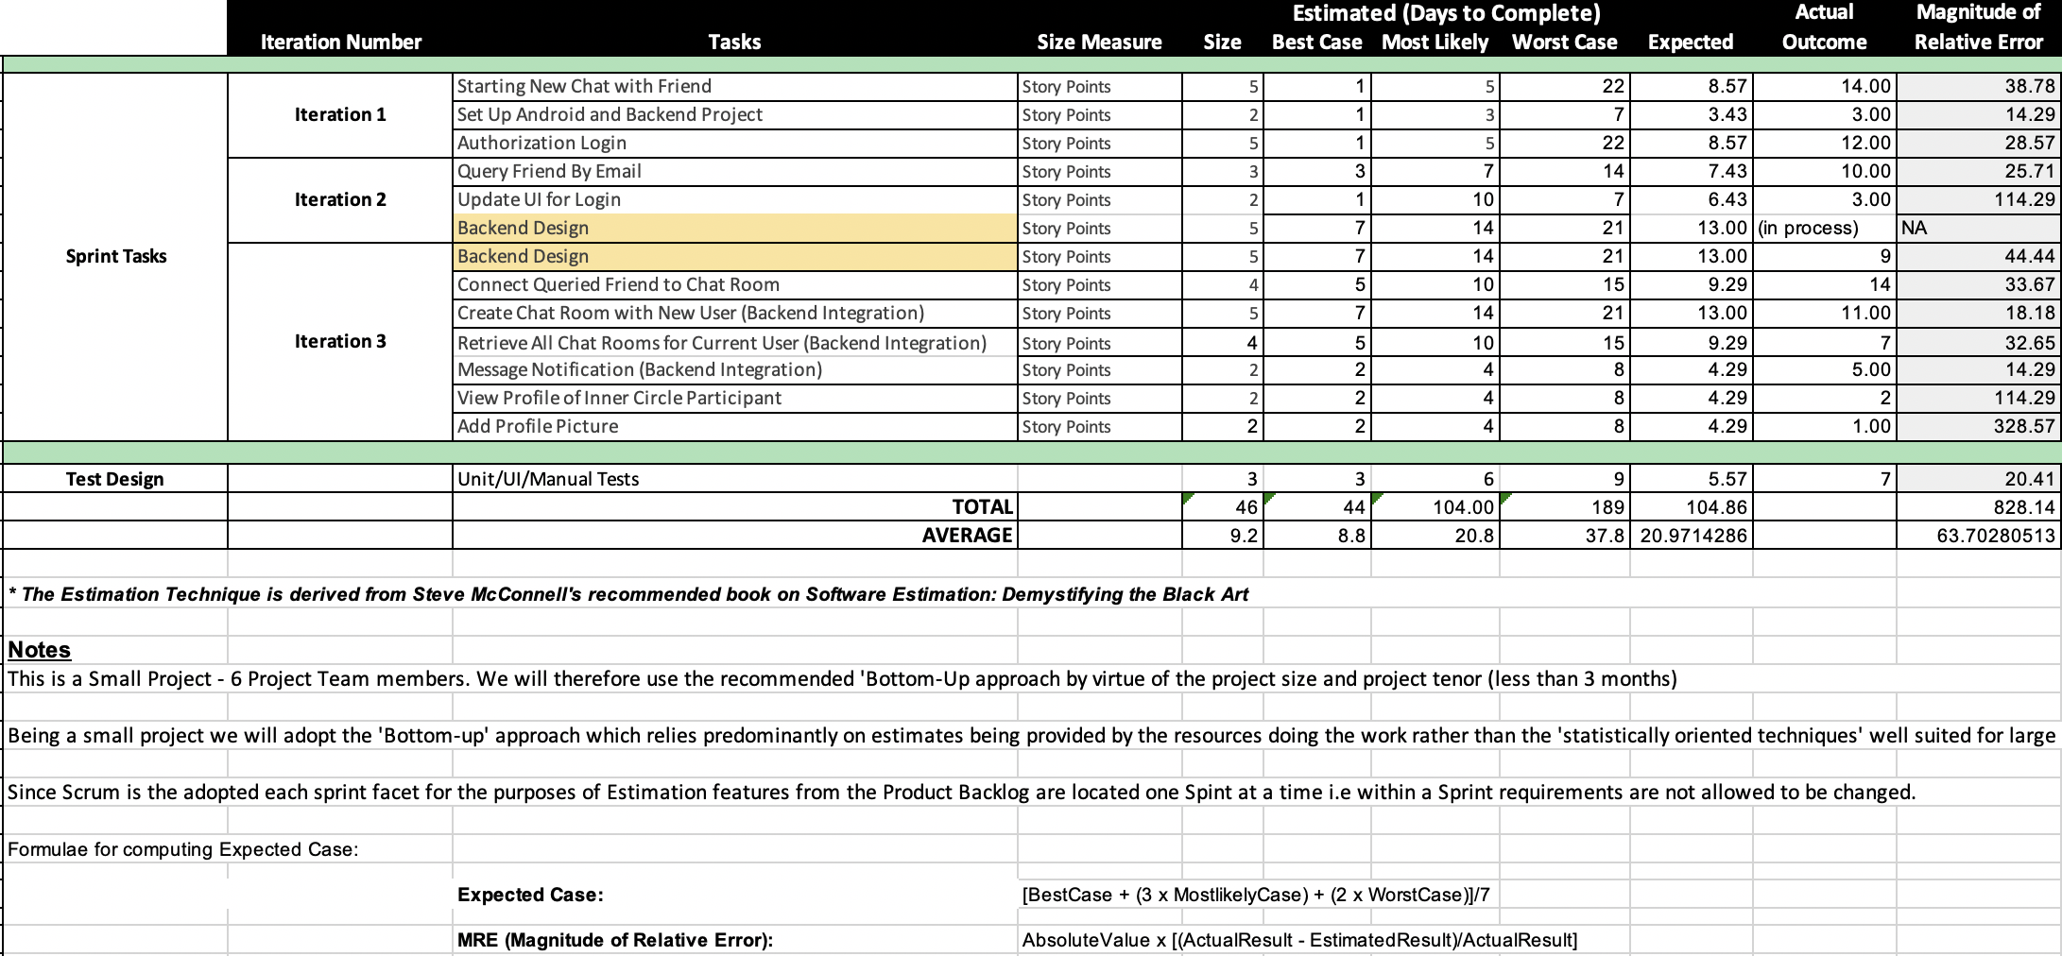
Project Management: Estimation
Management Note:
Difficult to record exact estimations teammates had full time jobs and other classes to attend to.
High Learning Curve for the first two iterations. T

Slide 40
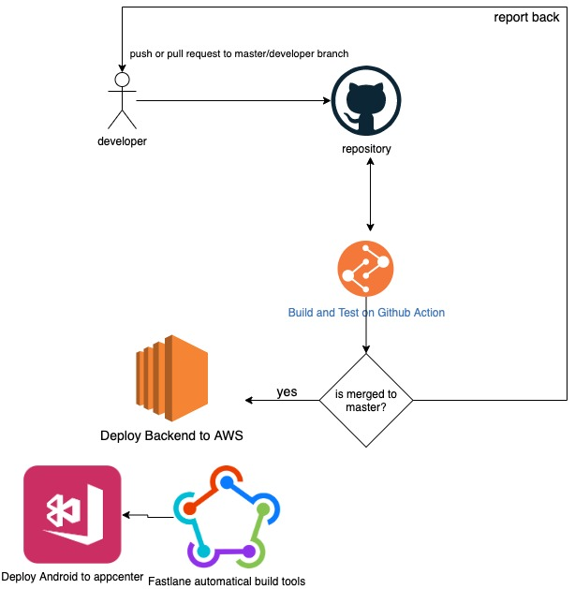
Deployment (Overview)

Slide 41
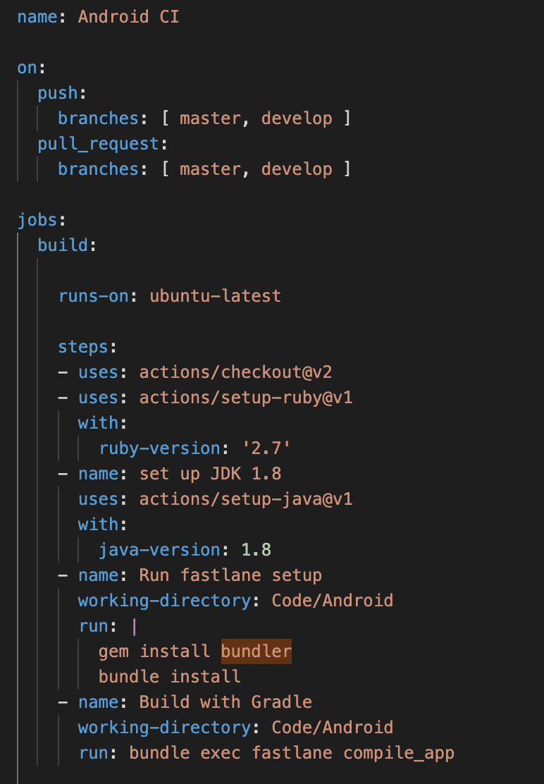
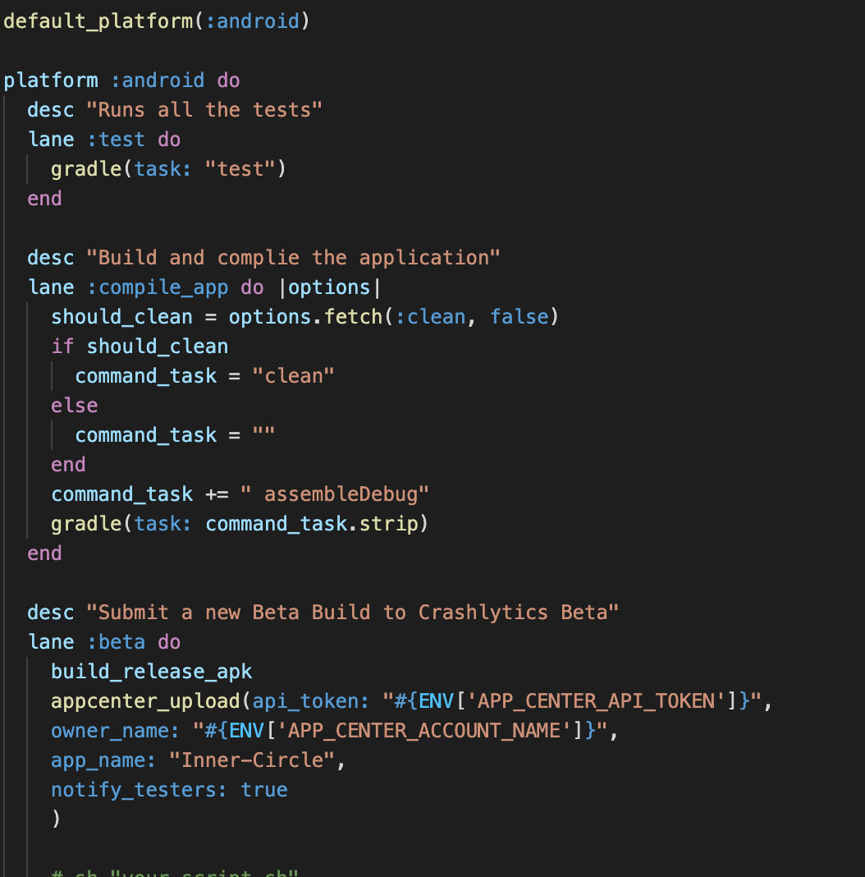
Configuration
Fastline build script to build Android
Android CI in Github Action

Slide 42
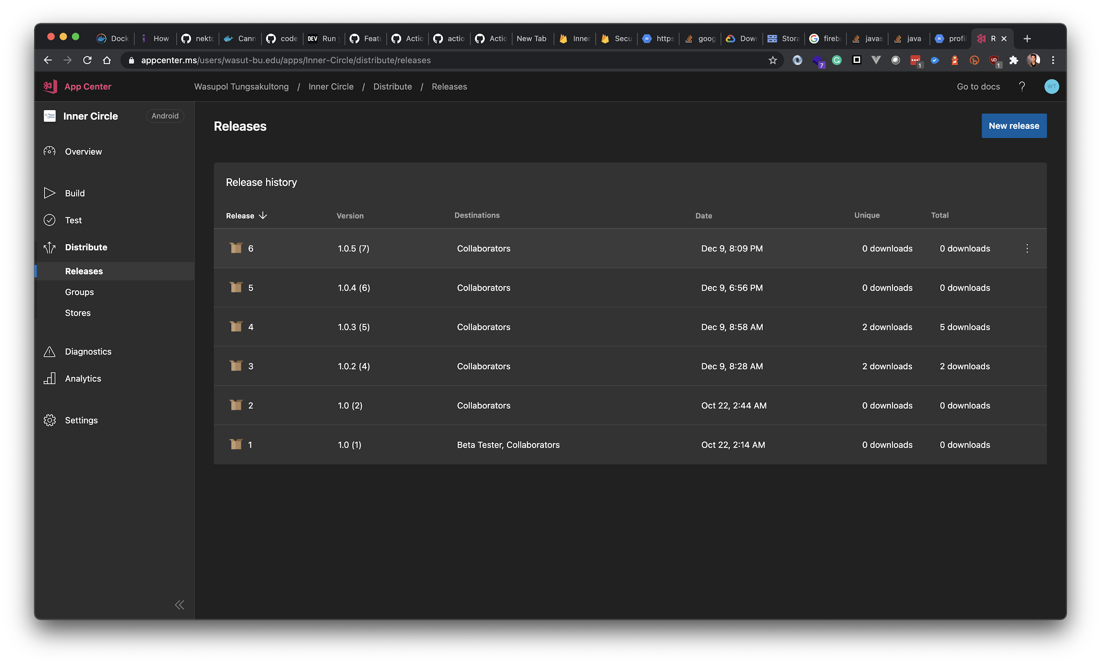
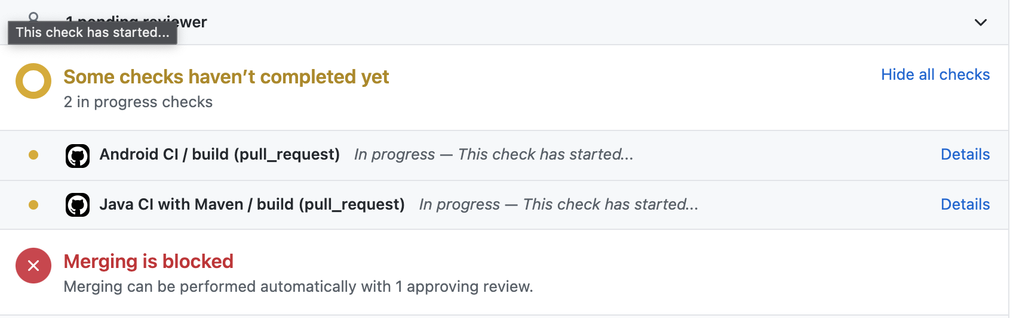
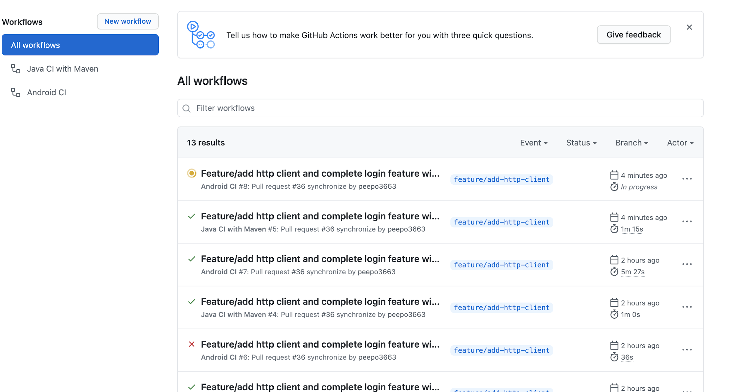
Deployment

Slide 43

Deployment tools
Open-source automatic build tools support various platforms (Android, iOS, Mac, Java, Gradle, Maven and etc.)
Save developer’s time
Developed on Ruby in Gem, Easy to maintain

Slide 44

Deployment distribution
AppCenter from Microsoft
Free and support multiple platforms
Used to be “AppHockey”
Easy to deploy and testing
Provide crash report
Amazon Web Service
Provide Free Tier for Unlimited time (t3.micro)
Support multiple platform.

Slide 45
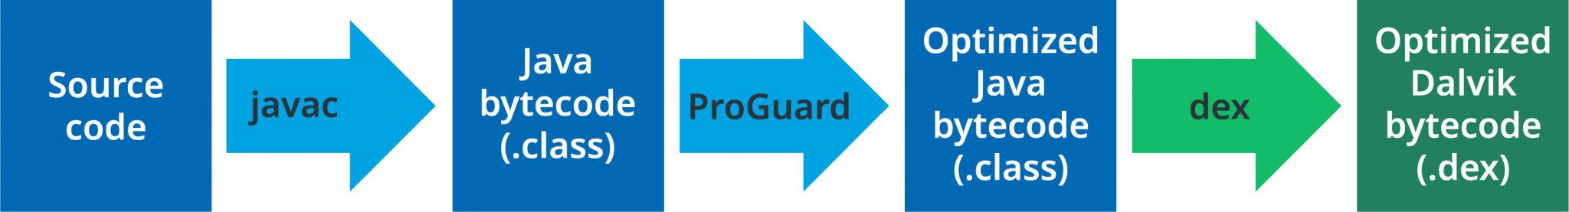
Security
App signing (Release Build)
Proguard and Minify Application Source code (APK)

Slide 46
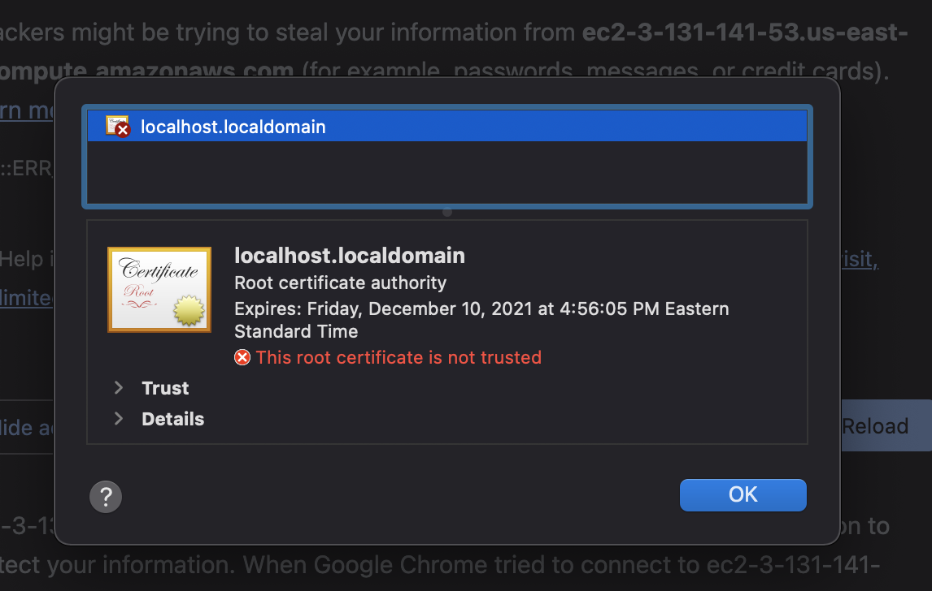
Security
Self-signed HTTPS (Pending)
Use self-signed by Amazon

Slide 47
Demo

Slide 48
Demo

Slide 49
Thanks

